Slide 1
Quick Test Professional
Mercury
Functional - Regression Testing tool
Author – Priya Mukunthan

Slide 2
TOPICS
Object Repository
Constructs
Checkpoints
Synchronization

Slide 3
About Object Repository

Slide 4
How QuickTest identifies objects
When you create a test by recording,QuickTest learns the properties of testobjects and are stored in Object repository. When the test runs, QuickTest searches for the object that matches the description it learned.
There are two types of object repositories:
Shared object repository : For multiple tests.
Action object repository : Separate repository for each action.Otherwise called as Object repository Per Action

Slide 5
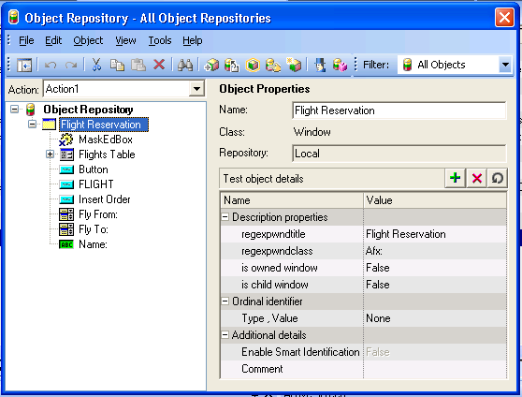
Object Repository

Slide 6
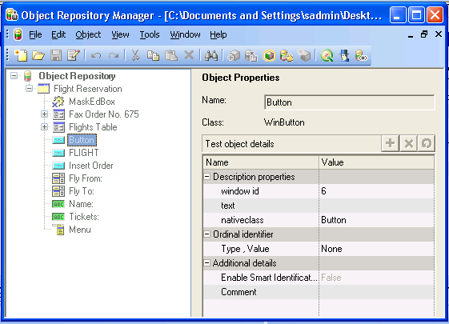
Object Repository Manager

Slide 7
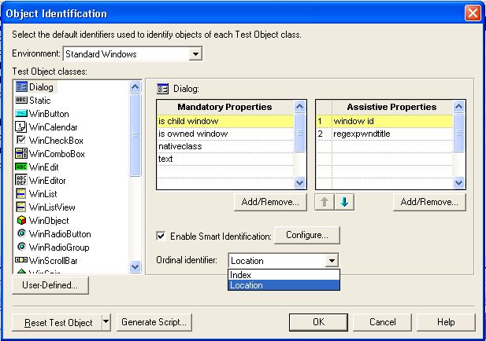
Object Identification

Slide 8
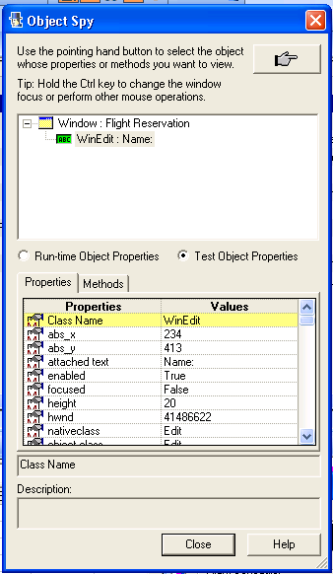
Viewing Object Properties Using the Object Spy
Tools = > Object Spy

Slide 9
Constructs
Conditional Statements
  If .. Then
  Else
  End If
  ElseIf … Then
Loop Statements
  For … Next
  Do… while
  Do… until

Slide 10
Example for If .. Else.. EndIf
If window("Notepad").Exist(2) Then
reporter.ReportEvent micPass, "Notepad dialog", "Notepad dialog exists"
Else
reporter.ReportEvent micFail, "Notepad dialog", "Notepad dialog exists"
End If

Slide 11
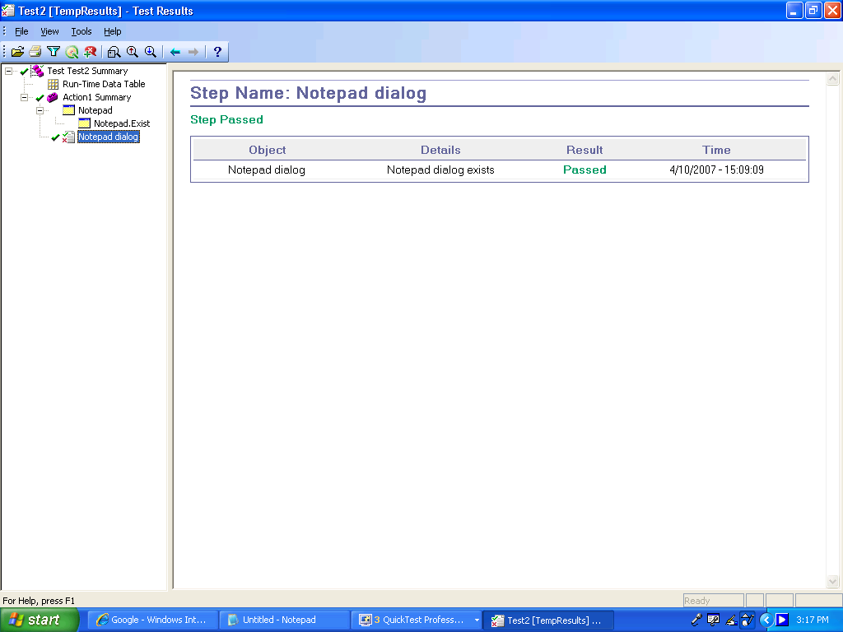
Test Result

Slide 12
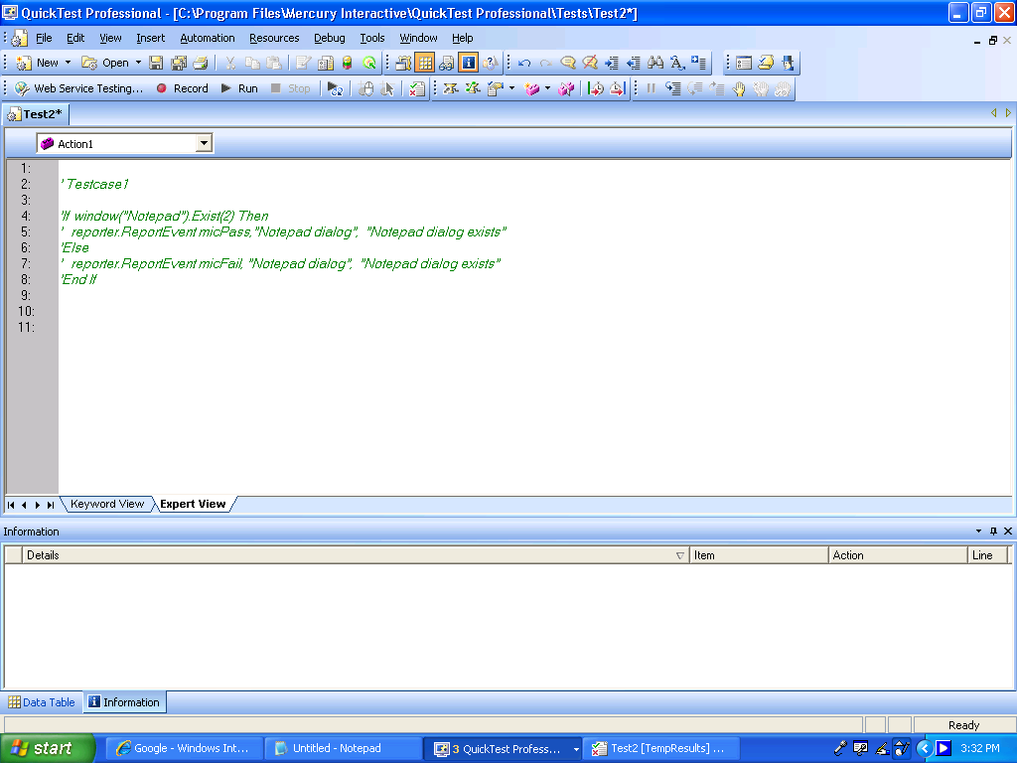
Usage of Comments
Comments - A comment is a free text entry that spans an entire row.

Slide 13
Checkpoints
A Checkpoint is a verification point that compares a current value for a specified property with the expected value for that property.

Slide 14
How Does a Checkpoint Work?
When you add a checkpoint, QuickTest adds a checkpoint with an icon in the test tree, and adds a Check CheckPoint statement in the Expert View.
When you run the test, QuickTest compares the expected results of the checkpoint to the current results. If the results do not match, the checkpoint fails

Slide 15
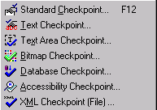
Insert => Checkpoint

Slide 16
Standard Checkpoint
The Standard Checkpoint checks a variety of
objects such as buttons, radio buttons, combo
boxes, lists, etc.

Slide 17
Creating Standard Checkpoint
Choose Insert > Checkpoint >Standard Checkpoint.
Click the object you want to check. Select an Object dialog box opens.
Select the item you want to check from the displayed object tree. The tree item name depends on the object’s class
Click OK. The Checkpoint Properties dialog box opens.
Click OK to close the dialog box.
A tree item with a checkpoint icon is added to your test tree.

Slide 18
Text Checkpoint
Checks that a text string is displayed in the appropriate place in your application or on a Web page.
For Web, mySAP, Siebel, PeopleSoft, and Terminal Emulator applications

Slide 19
Creating a Text CheckPoint
Highlight a text string on the page or screen.
Choose Insert > Checkpoint > Text Checkpoint
Click the text string.The Text Checkpoint Properties dialog box opens.
Specify the checkpoint settings.
Click OK to close the dialog box.
A tree item with a checkpoint icon is added to
your test tree.

Slide 20
TextArea Checkpoint
Checks that a text string is displayed within a defined area in a Windows application, according to specified criteria.
For Windows-based applications - Standard Windows, Visual Basic, ActiveX, and .NET Windows Forms.
Note: Text Area checkpoints are supported in Windows NT, Windows 2000, and Windows XP only.

Slide 21
Creating TextArea Checkpoint
Choose Insert > Checkpoint > Text Area Checkpoint.
Define the area containing the text you want QuickTest to check by clicking and dragging the crosshairs pointer.
Click OK to close the dialog box.
A tree item with a checkpoint icon is added to
your test tree.

Slide 22
Bitmap Checkpoint
Checks an area of your Web page or application
as a bitmap.

Slide 23
Creating Bitmap Checkpoint
Choose Insert > Checkpoint > Bitmap Checkpoint
Click an object to check in your Web page or application.
Click OK. The Bitmap Checkpoint Properties dialog box opens.
  If you want to check a small area of the bitmap, click the Select Area button.Use the crosshairs pointer to specify a small area.
Click OK to add the bitmap checkpoint to your test.
A tree item with a checkpoint icon is added to your test tree.

Slide 24
Database Checkpoint
Checks the contents of the database accessed.
You can use database checkpoints in your test to check databases accessed by application and detect defects.
You define a query on your database, and then you create a database checkpoint that checks the results of the query.
There are two ways to define a database query:
  Use Microsoft Query.
  Manually define an SQL statement.

Slide 25
In QuickTest, you create a database checkpoint based on the results of the query you defined on a database. QuickTest captures the current information about the database and saves this information as expected data.
A database checkpoint is inserted into the test script. This checkpoint is displayed in your test script as a DbTable.Check CheckPoint statement and as a step in the Tree View

Slide 26
Accessibility Checkpoint
Identifies areas of your Web site that may not conform to the World Wide Web Consortium (W3C) Web Content Accessibility Guidelines.

Slide 27
XML Checkpoint
Checks the contents of the XML documents. You
can create two types of XML checkpoints:
  XML Application Checkpoints:
  check an XML document within a Web page.
  XML File Checkpoints:
  check a specified XML file.

Slide 28
Creating XML Checkpoint
Choose Insert > Checkpoint > XML Checkpoint (File)
The XML Checkpoint from File dialog box opens.
Specify the path of an XML file.
Select the element(s) and/or value(s) that you want to check.
Click OK to add the XML checkpoint to your test.

Slide 29
Output Values
An Output Value is a value captured during the test run and entered in the run-time Data Table for use at another point in the test run.

Slide 30
Purpose?
When you create an output value, the test retrieves a value at the specified point during the test run and stores it in a column in the current row of the run-time Data Table.
You can create output values from property values for applications and Web pages, objects, and images.
Note:
You can also create output values from text strings and the contents of tables and databases.

Slide 31
Output Values
  Standard Output Value
  Text Output Value
  Database Output Value
  XML Output value ( From Application )
  XML Output value ( From Resources )

Slide 32
Synchronizing Your Test

Slide 33
When you run tests, your application may not always respond with the same speed. For example, it might take a few seconds:
  for a progress bar to reach 100%
  for a status message to appear
  for a button to become enabled
  for a window or pop-up message to open
You can handle these anticipated timing problems by synchronizing your test to ensure that QuickTest waits until your application is ready before performing a certain step.

Slide 34
Tests can be synchronized either of the ways:
Synchronization point
Exist or Wait statements
Increase the default timeout settings

Slide 35
What Is a Synchronization Point?
Definition:
A synchronization point is a line in the test script that instructs QTP to wait for a certain response from the application during playback.

Slide 36
Insert > Synchronization Point
Synchronization point, which instructs QuickTest to pause the test until an object property achieves the value you specify.
When you insert a synchronization point into your test, QuickTest WaitProperty step is displayed in the Tree View with the icon for the selected object. And also it generates the WaitProperty statement in the Expert View.

Slide 37
Parameterization
QuickTest enables you to expand the scope of a basic test by replacing fixed values with parameters. This process, known as parameterization, greatly increases the power and flexibility of your tests.

Slide 38
Parameterization and Data driver
You can parameterize a single step by using its Method Arguments option
You can use the Data Driver enables you to quickly parameterize several (or all) objects, methods, containing the same constant value within a given action.

Slide 39
Parameter Types
Test/action parameters
Data Table parameters
Environment variable parameters
Random number parameters

